Slide 1



API World 2020- Hackathon
Elroy lobo

Slide 2


About me:
I am aspiring data scientist and a student pursuing a computer major at University of California (SC)
While I am conversant with Django and other UI frameworks, I wanted to focus on the data science aspects of the hackathon and not get weighed* down by the UI aspects (e.g. react).
Hence, I focused on using the Here Dev REST API (as a primary data source) and then build my own python app. The advantage of using Python (as opposed to say Java) is the rich set of AI/ML/NLP libraries available
(* I also have a full course load going now and hence had very limited time to prototype my idea :))
Elroy Lobo,
San Jose,
CA, USA:
elroylobo@live.com
+1 669-210-3968

Slide 3
APP goal:
Using AI/ML/NLP find business with certain user-defined characteristics.
Examples:
Is the business offering new promotions (e.g. discounts)? .. Who doesn’t like to save?
Which Starbucks is open at late hours? .. I was busy at work, but I want to pick up my fav latte.
Which CVS is co-located in a supermarket? … I am busy and want to do pick up medicines when I am doing my grocery run
Is the business hiring? … I could get a coffee and probably check out the business too while I am there
: : :

Slide 4
Technologies used:
INPUT
(in natural language):
Which CVS is co-located within Target around me?
PySimpleGUI
(UI)
(Can be replaced by DJANGO, React, etc.)
AI/ML
Web Scraping
NLP (Natural language processing) libraries
Alexa/Siri integration
Converts user input into REST API parameters
e.g. &location, &type, etc.
Output:
CVS on 123 Smith Ave, San Jose is located within Target
PySimpleGUI
(UI)
(Can be replaced by DJANGO, React, etc.)
HERE Dev REST APIs

Slide 5
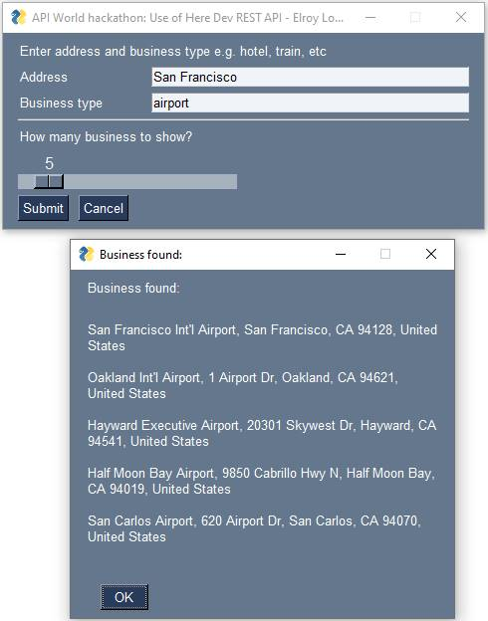

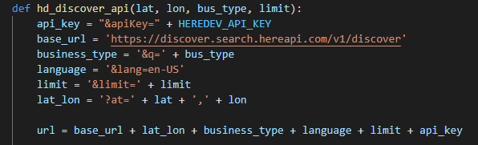
Basic ui (actually implemented (Python source code included!) (GUI was built using pySimpleGUI)
Enter your address:
The address could be a complete address or just a city or a state… i.e. free flowing
Free flowing input was possible because the Here Dev RESTAPI (‘discover’) is flexible for providing this kind of generic search.
Business type:
e.g. airport
Slider to limit # of business to show:
e.g. airport
Code snippet
Used /discover
REST API from
Here Dev
Output:
List of 5 airports around San Francisco

Slide 6
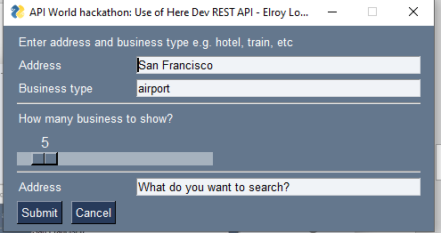
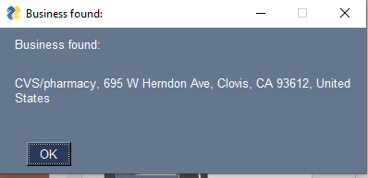
Additional ui (proposed) (Python source code included!) (GUI was built using pySimpleGUI )
What do you want to search:
e.g. Which CVS is co-located in a supermarket?
Code snippet
- First supermarkets will be found using
&q= supermarkets
Then another search will be done using the above results + append ‘CVS’ to &q
Output:
Business that has CVS collocated in a supermarket (Target in the above example)

Slide 7
summary:
There are plethora of apps that show standard information about businesses but very few that can process normal human questions and provide meaningful information. The app uses AI/ML/NLP and the HERE DEV REST API as data source.
The ability to process normal human queries is especially useful when one is busy (e.g. driving) or those who are less computer savvy.
Unlike a lot of examples on the Here Dev site that are front-end oriented and use some UI stack(react/flask/ect), I have focused on using the Dev Here REST API for data source and providing value add building my own logic for AI/ML/NLP. This is very useful for data science folks such as me.
elroylobo@live.com
+1 669-210-3968

